Slide 1

Project Experience
Yueqian Liu | 刘越千
HITSZ

Slide 2


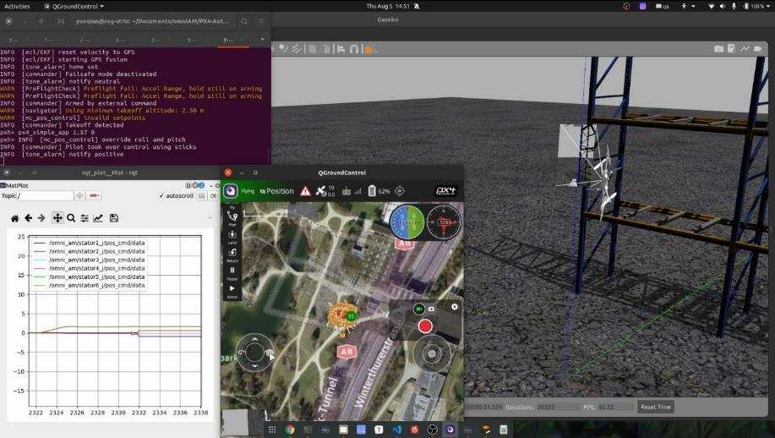
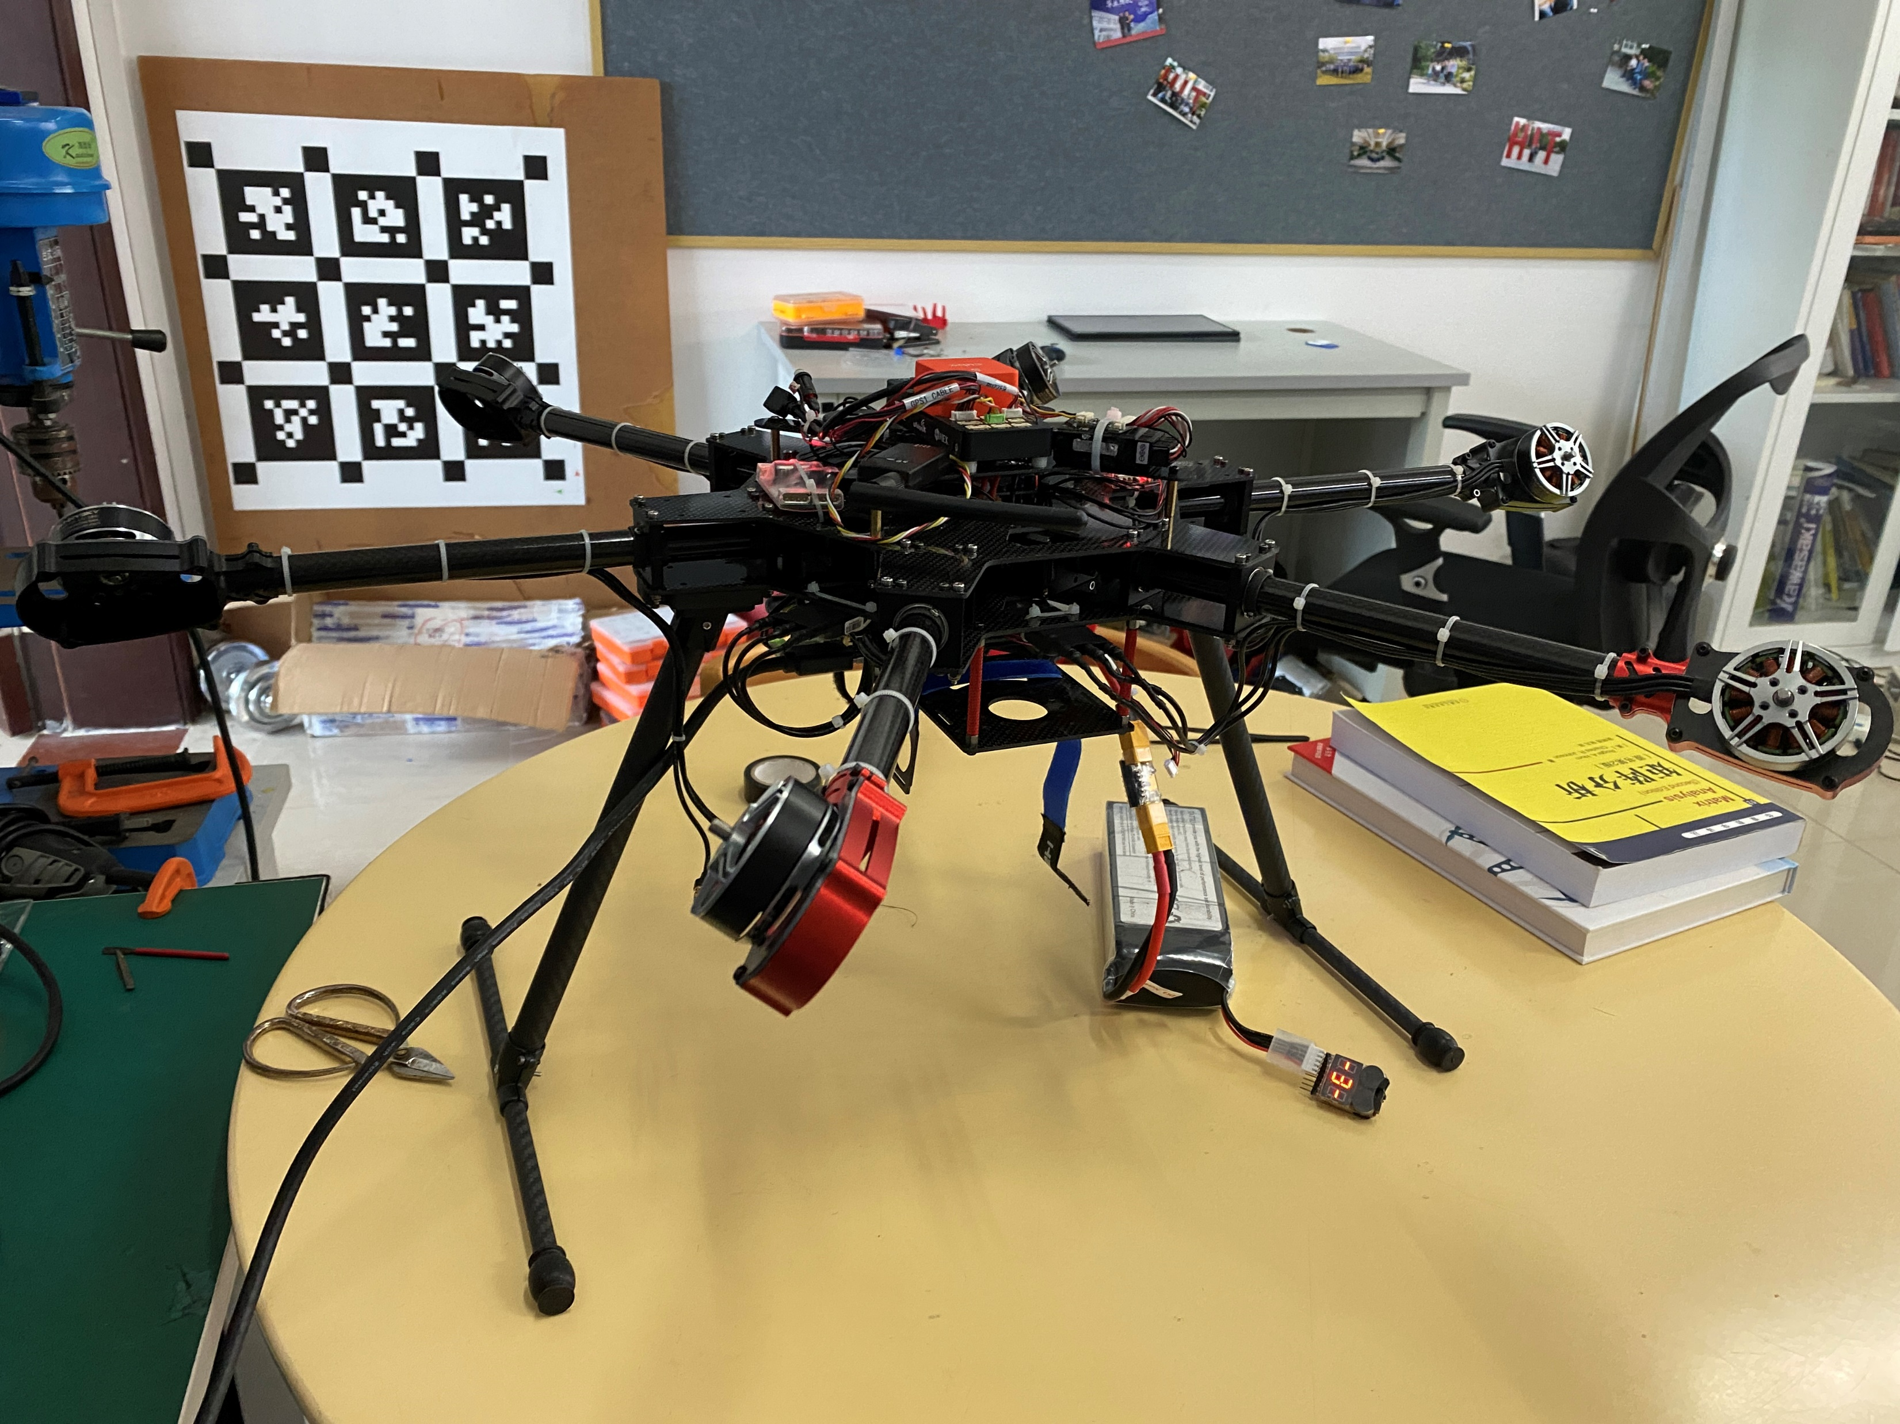
Omnidirectional Hexacopter Platform
This project is currently in active progress of development. It will probably be my bachelor thesis project.
Implemented a dynamics-based control allocation algorithm on PX4 following the work done by ASL, ETH.
Looked into PX4 control pipeline which was then adapted for full wrench control.
Basic control decoupling and omni-maneuverability was verified using PX4-SITL and Gazebo in ROS environment.
Using novel configuration: PX4 running on CUBEPILOT and ros2 nodes on NUC11PAHi7.
Notes:
the first one is (title)
our goal is to build a hexacopter that could hover and fly in arbitary attitude, which serves as a great platform for future research on trajectory planning and aerial manipulation
(line 1)
what i did in a nutshell was...(line 2, 3)
(line 4)
one feature is that we are (line 5), but ros1 is also supported
how can it fly in ana arbitary attitude? well, it is achieve by having thrust vectoring as illustrated on the right side

Slide 3
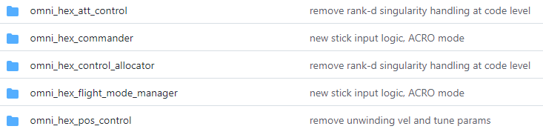
Controller Pipeline
attitude_setpoint
rates_setpoint
angular_vel_ctrl
mc_pos_ctrl
normalized thrust
attitude
RPY
mc_att_ctrl
normalized thrust
rates
RPY
ctrl_alloc
mass & inertia
force_setpoint
where actual decoupling takes place
passthrough
where control allocation takes place
P controller
PID controller
torque_setpoint
For under actuated MCs, attitude setpoint is obtained according to thrust setpoint, the output of position P-PID controller, as the desired body z-axis.
In this project, attitude setpoint is independent from thrust setpoint and is set according to flight modes, stick input or application override.
man_ctrl_sp
stick inputs override
At first modified modules appear as independent modules with the omni_hex prefix so they are not effected by the update of official code. On the other hand, they lose the chance to be updated by official devs, which isn’t optimal. So they we turned to using git branch to manage difference versions.
Notes:
In case that someone is umfamiliar with how px4 works, I think I'll briefly introduce the control pipeline and how it was modified.
It is a cascaded control diagram. we have (modules) running in independent loops and they communicate through messages using a middleware called microORB system.
(left paragraph), which is the mechanism illustrated here.
So the setpoints goes all the way down to this angular velocity controller, and it outputs the desired wrench according to the vehicles kinematics model.
then the ctrl allocator maps the wrench setpoint to actuator outputs, by which I refer to motors and servos PWM setpoints.
(down para)

Slide 4
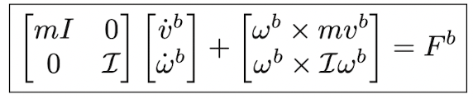
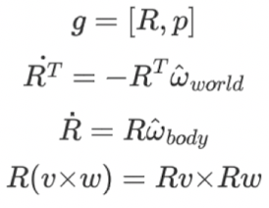
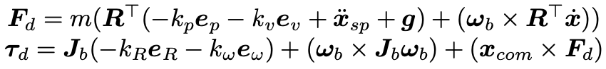
Controller Pipeline
Vehicle dynamics are delineated by the body-frame Newton-Euler equations.
Notes:
Let me talk a bit more about the dynamics, because it is crucial in this project.
As mentioned before, they are implemented into the pos controller and angular rate controller.
and (line1). This equation is commonly seen in any robotics textbooks. It answers how a rigid body would move under a given wrench. Or you can see it as a advanced form of the F=ma in body frame.
Right now, (line 2)
The term in the box is …(orange)
Ok, so much for controller, upcomings are about control allocation

Slide 5
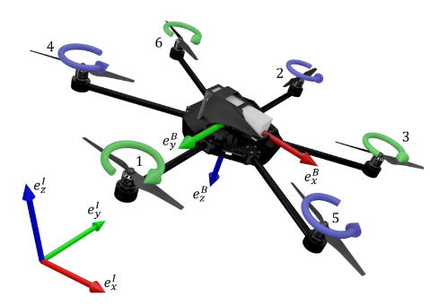
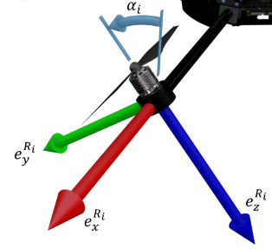
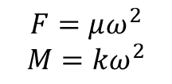
Control Allocation: Map Wrench To Actuator SP
Elkhatib et al, Control Allocation of a Tilting Rotor Hexacopter, 2017
Primitive allocation matrix involves sines and cosines of tilting angles, which is dynamic.
Static allocation is derived by moving sines and cosines into the solution vector.
Bodie et al, Towards Efficient Full Pose Omnidirectionality with Overactuated MAVs, 2018
We only adopt method used in the kinematic singularity scenario.
$$F=μω^{2}$$
$$M=kω^{2}$$
Notes:
First of all, allocation means(title)
There is already a good solution on how to do it, by ETH. Specifically these two papers.
(line1) and it is not computer friendly, so we want a staic matrix and luckily there is one.(line 2), you’ll see in the next slide
In the second paper here, some singularities are discussed but that not trivial so I don’t want to ellaborate on that.

Slide 6
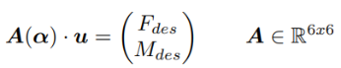
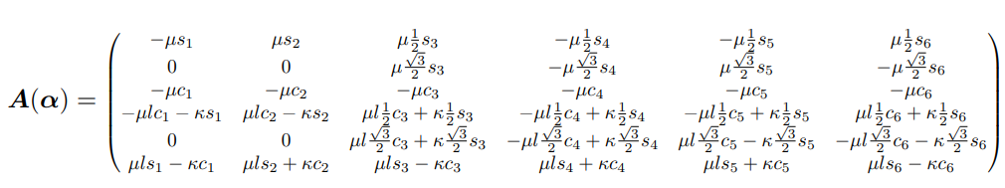
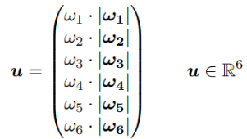
Control Allocation
This is a simple total force composition problem.
Notes:
Alright, umm equations.
So we have the wrench setpoint given by controller. And we need to calculate the actuator output u. U is a vector of six motor angular velocities. And servo rotation angles are buried in matrix A
A of alpha is the above mentioned dynamic matrix. It is derived by doing a simple total force composition.

Slide 7
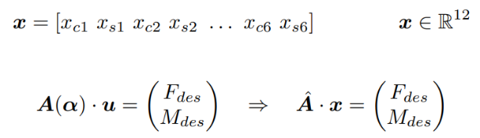
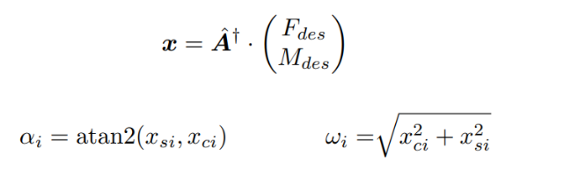
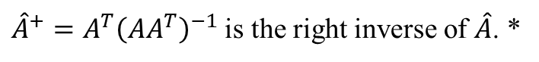
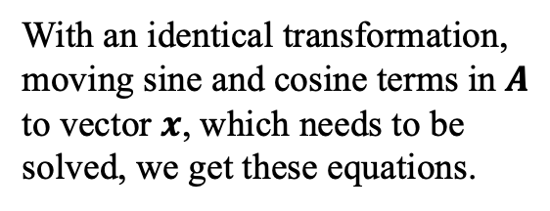
Control Allocation
With an identical transformation, moving sine and cosine terms in $A$ to vector $x$, which needs to be solved, we get these equations.
${\hat{A}}^{+}=A^{T}{\left(AA^{T}\right)}^{−1}$ is the right inverse of $\hat{A}$. *
Solving for tilt angle and rotor angular velocity from each x pair.
* Using right inverse (pseudo inverse) gives the least norm optimized solution, which is best suited for efficient flight.
Notes:
Now the dynamic matrix is clear
But we want a static one so stm32 chips and handle the calculation
This is done (para 1)
Then we solve the linear equations set
Notice, that the matrix is a 6 by 12 matrix so the right inverse is used and it gives us (last para)
Okay we are really close to nailing it. Notice how x is composed, we need to extract motor velocities and servo rotation angles. This is given by these two equations.

Slide 8
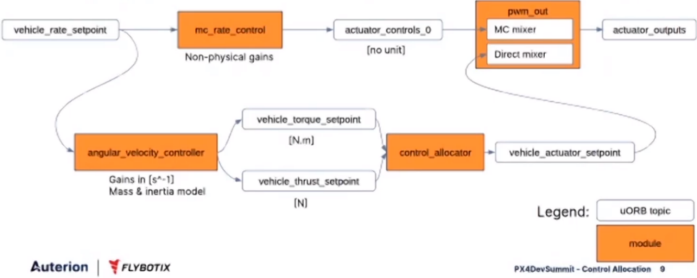
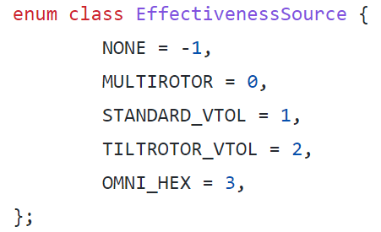
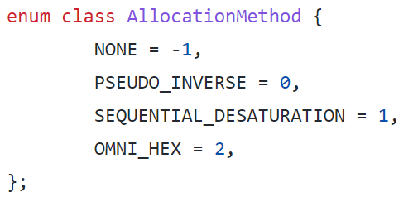


Control Allocation
Julien Lecoeur, Control Allocation: Reworking the PX4 Mixing System, PX4 Developer Summit, Virtual 2020
A new feature introduced to PX4 in late 2020 greatly reduced software architectural complexity (compared to ETH).
A new part introduced in late 2020.
VERY USEFUL ARCHITECTURE.
Notes:
Now we done for math.
How did we manage to implement such algorithm on a PX4 flight controller?
Well, thanks to (line 1)
It is like a passthrough sort of thing. Our CA be easily added to the PX4 native code by adding sub classes.

Slide 9
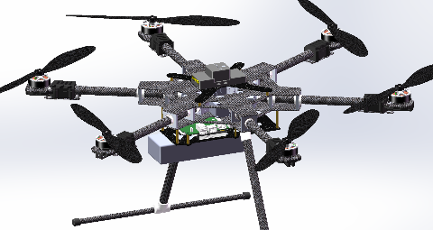
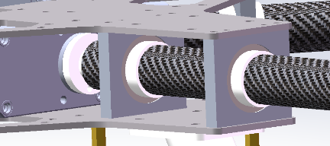
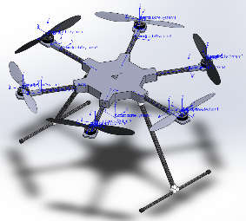
Software In The Loop Simulation with Gazebo
Wrote a gazebo plugin to control joint behavior.
It is very similar to the ros_control_plugin, but is easier to use and works with sdf files.
Listens to position or velocity commands in certain topics and apply PID control to targeted joints in gazebo.
Added a custom Mavlink message and Mavros plugin to send out joint position command.
Nothing complex, just following instructions and docs.
We are now moving to ROS2 for real time data communication.
Main structures are all made with carbon fiber.
Bearing is used to ease rotation.
Notes:
About the simulation part(read)
Below are cad models and (line down)

Slide 10
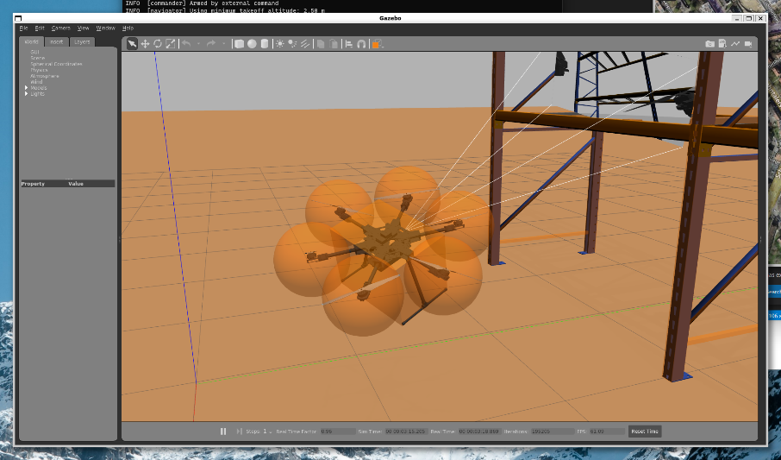
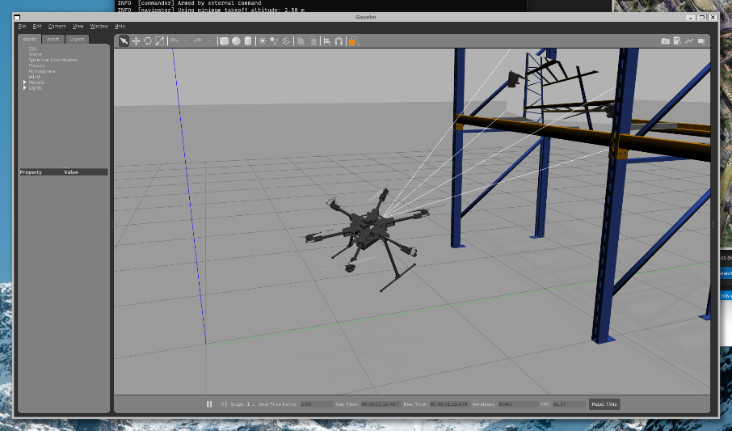
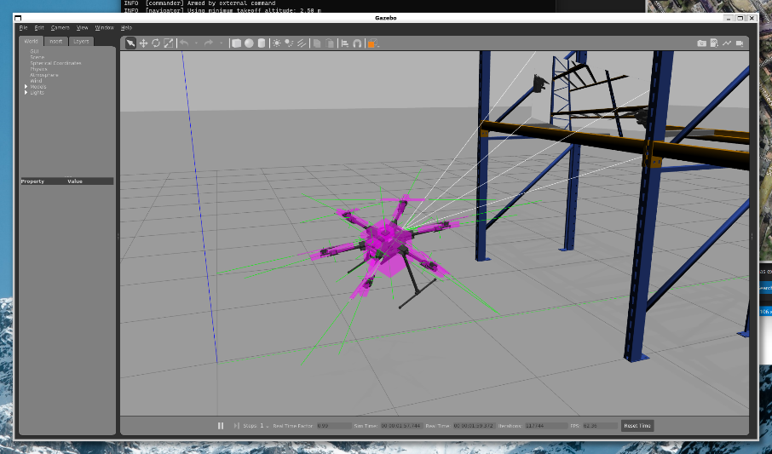
Model Update (Nov 11)
Mass and inertias are neatly modeled.
Sensor plugins are carefully placed to match real world robot.
Dynamics properties are set carefully to increase simulation real time factor.
Notes:
About the simulation part(read)
Below are cad models and (line down)

Slide 11
TODOs (Updated on Nov 11)
Controller performance: slow dynamics of arm joints & unmodeled dynamics
Brunner et al, Trajectory Tracking Nonlinear Model Predictive Control for an Overactuated MAV, 2020
Use adaptive MPC
Zhang et al, Learning dynamics for improving control of overactuated flying systems, 2020
The core idea is to learn the model-plant mismatch from test data.
This method faces the generalization problem. I’m thinking about using online identification.
Cable winding
Allenspach et al, Design and optimal control of a tiltrotor micro-aerial vehicle for efficient omnidirectional flight, 2020
Do allocation on derivative level: output servo angular velocity and motor acceleration, better for tracking and null space exploiting.
The work around now is limiting the attitude space. If a state violates the arm rotation limit, it won’t be executed.
Integration with a manipulator arm
Bodie et al, Dynamic End Effector Tracking with an Omnidirectional Parallel Aerial Manipulator, 2021
Accurate state estimation without using OPTITRACK
Choe et al, Volumetric Propagation Network: Stereo-LiDAR Fusion for Long-Range Depth Estimation, 2021
LIO/VIO Sensor fusion & SLAM
Look into Fei Gao’s work and incorporate technics into this project.
Notes:
To wrap up this project, I present the todos, future work.
First, we need to do better on controller performance by considering (line 1), we can also add DOB and ESO or even do and identification of unmodeled dynamcis, you know, airflows and ground effects. Beacause we need to mount arms, so optimal controller performance is required.
Second is about cable winding. This is problem if one let it do flips, during which the arms rotate and wind up the cables. What eth did was (line ?). Since it isn’t senseless and we havent com up with a better idea so (line)
Future work also includes the(titles)

Slide 12
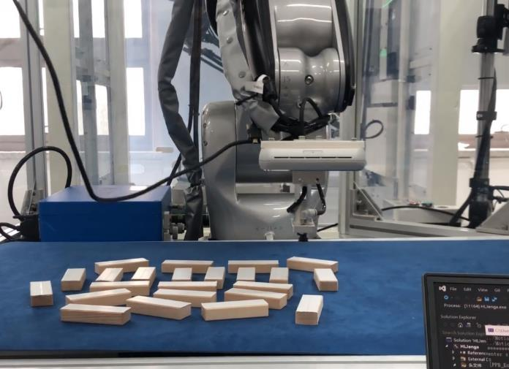
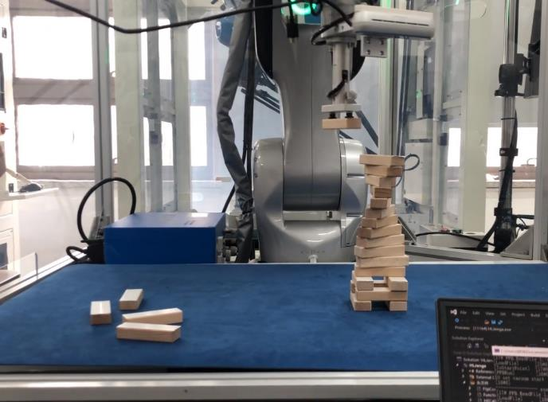
Hexalink Jenga Manipulator
This is a coursework project for Mathematical Introduction to Manipulators class.
We were required to program QKM manipulators to play Jenga automatically.
My part was doing hand-eye calibration, blob analysis, path/trajectory planning and simple UI.
Take a picture with camera and calculate target positions.
Do path and trajectory planning.
Upload planned trajectory to bot.
Run.

Slide 13
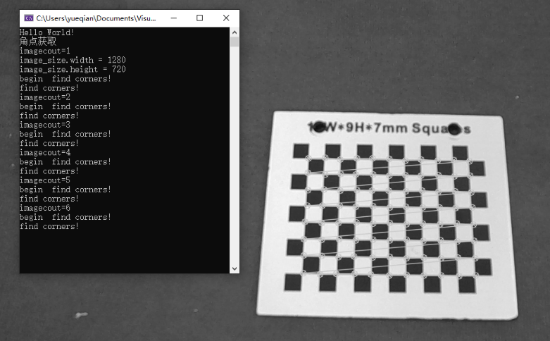
HE Calibration: In a Nutshell
Aims to find the transform matrix from camera frame to tool frame.
Intrinsic params: cv::calibrateCamera()
Solve for pose of the calibration board in camera frame: cv::solvePnP()
Solve for end effector transformation matrix and use cv::calibrateHandEye() to finish the process.
Notes:
I wanna talk about HE calib for a while, it aims to (line 1)
To do this we need a calib board.
Next slide better illustrates the process.

Slide 14
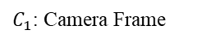
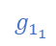

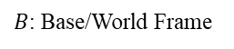
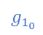
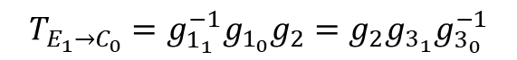
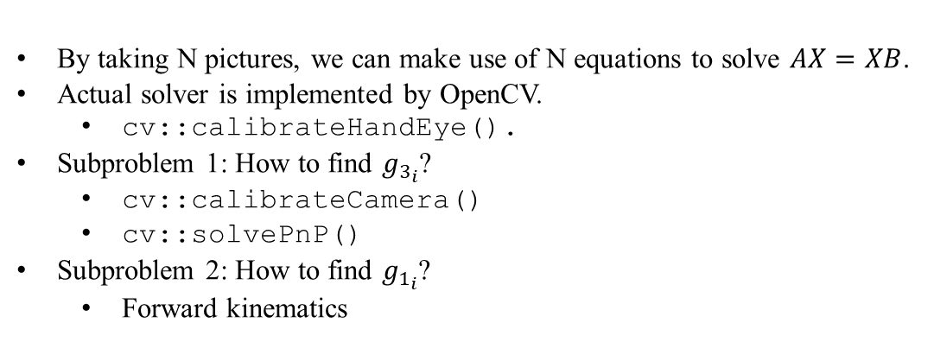
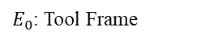
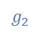
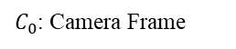
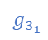
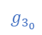
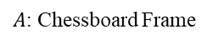
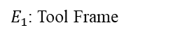
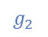
HE Calibration: Essentially Solving The $AX=XB$Problem
$A$: Chessboard Frame
$$T_{E_{1}→C_{0}}=g_{1_{1}}^{−1}g_{1_{0}}g_{2}=g_{2}g_{3_{1}}g_{3_{0}}^{−1}$$
$$g_{3_{0}}$$
$$g_{3_{1}}$$
By taking N pictures, we can make use of N equations to solve $AX=XB$.
Actual solver is implemented by OpenCV.
cv::calibrateHandEye().
Subproblem 1: How to find $g_{3_{i}}$?
cv::calibrateCamera()
cv::solvePnP()
Subproblem 2: How to find $g_{1_{i}}$?
Forward kinematics
$C_{0}$: Camera Frame
$C_{1}$: Camera Frame
$$g_{2}$$
…
$$g_{2}$$
$E_{1}$: Tool Frame
$E_{0}$: Tool Frame
$$g_{1_{0}}$$
$$g_{1_{1}}$$
$B$: Base/World Frame
Notes:
The process is illustrated here, we take pictures of the board form different points, collect data and solve an AX=XB problem.
So we aims to find the transformation from tool frame to cam frame, which is g2. so in this equation (point), g2 is the X if we formulate a AX=XB problem. This equation describes two paths from E1 frame(here) to C0 frame(here). And with N pictures we have a set of equations like this. Then we use the (…) to solve for g2.
In order to write the set of equations, we also need to know what g3’s and g1’s are because they are A and B s.
G3 can be solved by caling ()
G1 can be solved by doing forward kinematics

Slide 15


HE Calibration: Finding $g_{3_{i}}$
Chessboard Info & Image
cv::solvePnP()
cv::calibrateCamera()
$$g_{3_{i}}$$
camera matrix
&
distortion matrix
Notes:
So this is the pipeline of finding g3
As I said we use ().

Slide 16
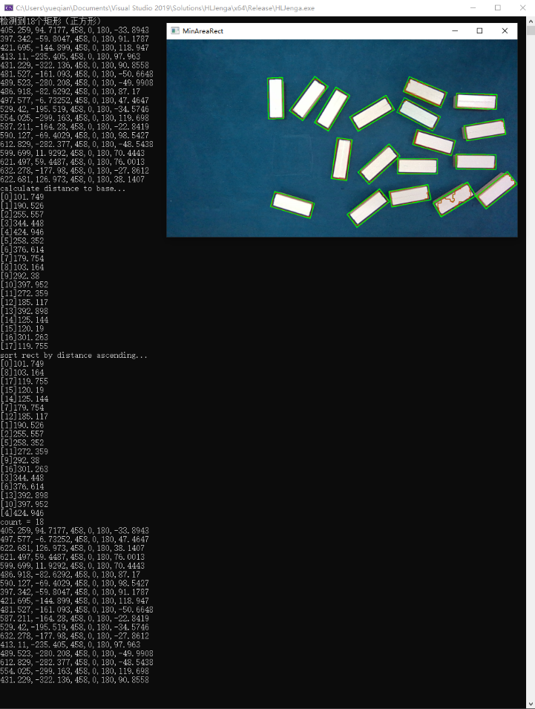

Jenga Detection: Blob Analysis
RGB to HSV
Get blob areas based on color filtering.
Apply morphology process to eliminate cracks and dots.
Find blob contours and corresponding minAreaRect.
Coordinates transformation:
Pixel frame to camera frame: $q_{pixel}z_{c}=KDq_{camera}$
Camera frame to world frame: $q_{world}=g_{1}g_{2}q_{camera}$
Sort targets by the distance to base in ascending order.
Notes:
The last piece of puzzle is picking out jenga blocks with rgb camera
(..)
We do this because we need to take into consideration of the height of already built structure and make sure that the planned path does not crush it.

Slide 17
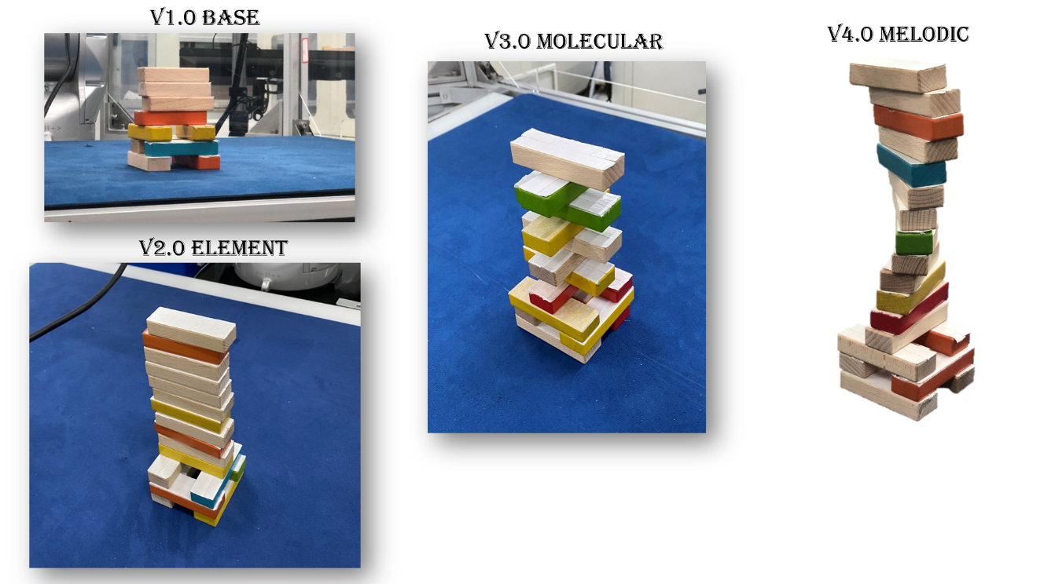
Path Planning
Wrote a developer friendly coding architecture that allows us to define the final structure style by changing a few parameters.
Upper structure deviation angle
Picking order
Base location
Notes:
So much for the vision part.
Next, it is path planning.
(…)

Slide 18
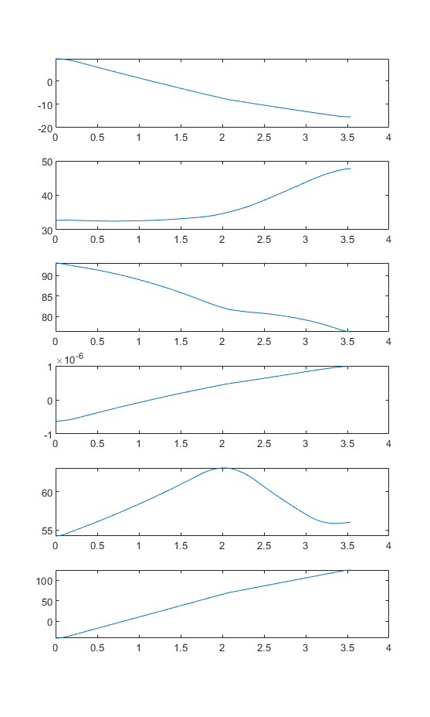
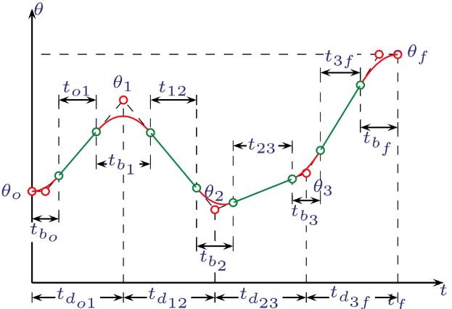
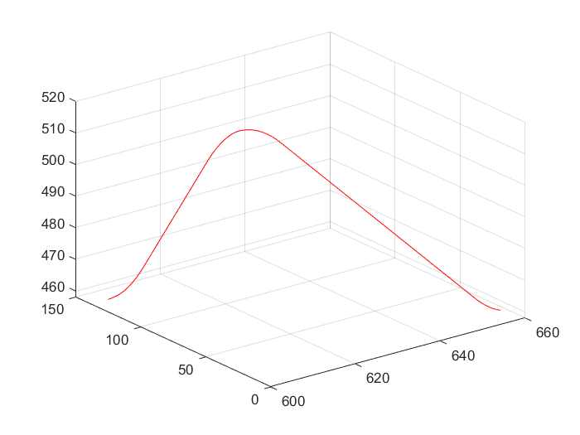
Trajectory Planning
Linear function with parabolic bends and via points
Apply inverse kinematics with given starting, ending and via points to find corresponding points in joint space.
Doing trajectory planning in joint space directly is much faster because of absence of calculating inverse.
To avoid collision and damage, trajectories are first visualized in MATLAB.
Notes:
With the path, we can generate trajectories. This wasn’t my part, but I know how it works…
I mean everyone in the class knows because it is taught in class.
(…)
And that is pretty much all of it…

Slide 19
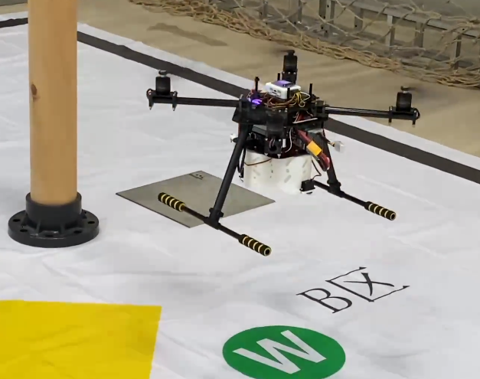

Autonomous Delivery Drone
Designed UAV airframe (including cargo hold) and overall software architecture.
Wrote code on a flight controller to execute commands received from a companion computer.
Nothing interesting or related to cutting-edge research. Just an engineering level practice.
https://www.bilibili.com/video/BV1AV411J7UV
Notes:
The third project, the auto delivery drone.
We achieved delivering cargo to marked points on the ground with flight autonomy
(…)

Slide 20


Some Technical Approaches
Localization: optical flow, TOF sensor
Detection and navigation: YOLO + KCF + Hough Circle Transform on TX2
Flight controller: ACFLY ADRC
Communication between FC and TX2: velocity command through serial UART
Notes:
Let me just quickly go through our solution
For …
And yeah, nothing really related to cutting edge research

Slide 21

Design and Control of A 3-Rotor VTOL UAV
A project for The Freshman Year Innovation Program of HITSZ.
Designed UAV hardware; Made a mixing unit to achieve VTOL flight and hover-fixed-wing transition.
The mixing unit takes in PWM outputs of a basic multicopter flight controller and yields signals for VTOL actuators.
Notes:
The last one I want to share is the vtol uav that I made during the first year of collage.

Slide 22


System Overview
VTOL is achieved by adding a mixing unit to the F4 flight controller running Betaflight Y3 firmware.
The mixing unit takes in PWM outputs of a basic multicopter flight controller and yields signals for VTOL actuators.
We only implemented attitude control.
Communication between boards is via PWM.
https://www.bilibili.com/video/BV1H4411o7Gq

Slide 23







Some Naïve Math

Slide 24


Wrapping Up
This project is more like a RC fan project instead of a decent research project and it was conducted in my early college years. Quantitative data and dynamics analysis are therefore missing. But it was really fun anyway.
If I were to rebuild a vehicle like this, I would just use PX4 and modify the control allocation module, which is easier and more elegant.

Slide 25
Additional Info
More projects and video demos can be found here: https://space.bilibili.com/16031917.
As those not-so-important ones are listed in EXTRACURRICULAR ACTIVITIES section in my CV, they are not described in detail in this file.
For more detailed description in Chinese, please refer to links in the CV.
In order to describe what I’ve done explicitly, if not accentuated with a standalone slide, words are in BOLD BLUE format.
Details of early projects are included in the attached PDF files.

Slide 26
#include <iostream>
int main()
{
std::cout << "Thank you for reading." << std::endl;
return 0;
}

